Slide 1
Courageously Created Worthy
“‘And you must love the Lord your God with all your heart, all your soul, all your mind, and all your strength.’ The second is equally important: ‘Love your neighbor as yourself.’ No other commandment is greater than these.” Mark 12:30-31 (NLT)

Slide 2
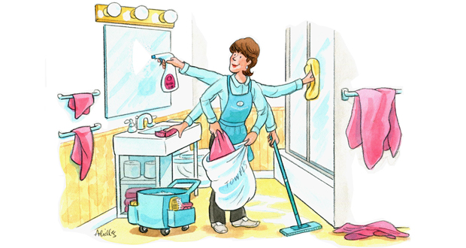
Housekeeping
Vegas Rule
Share your feelings, not the experience
Ask questions
Let’s talk more

Slide 3
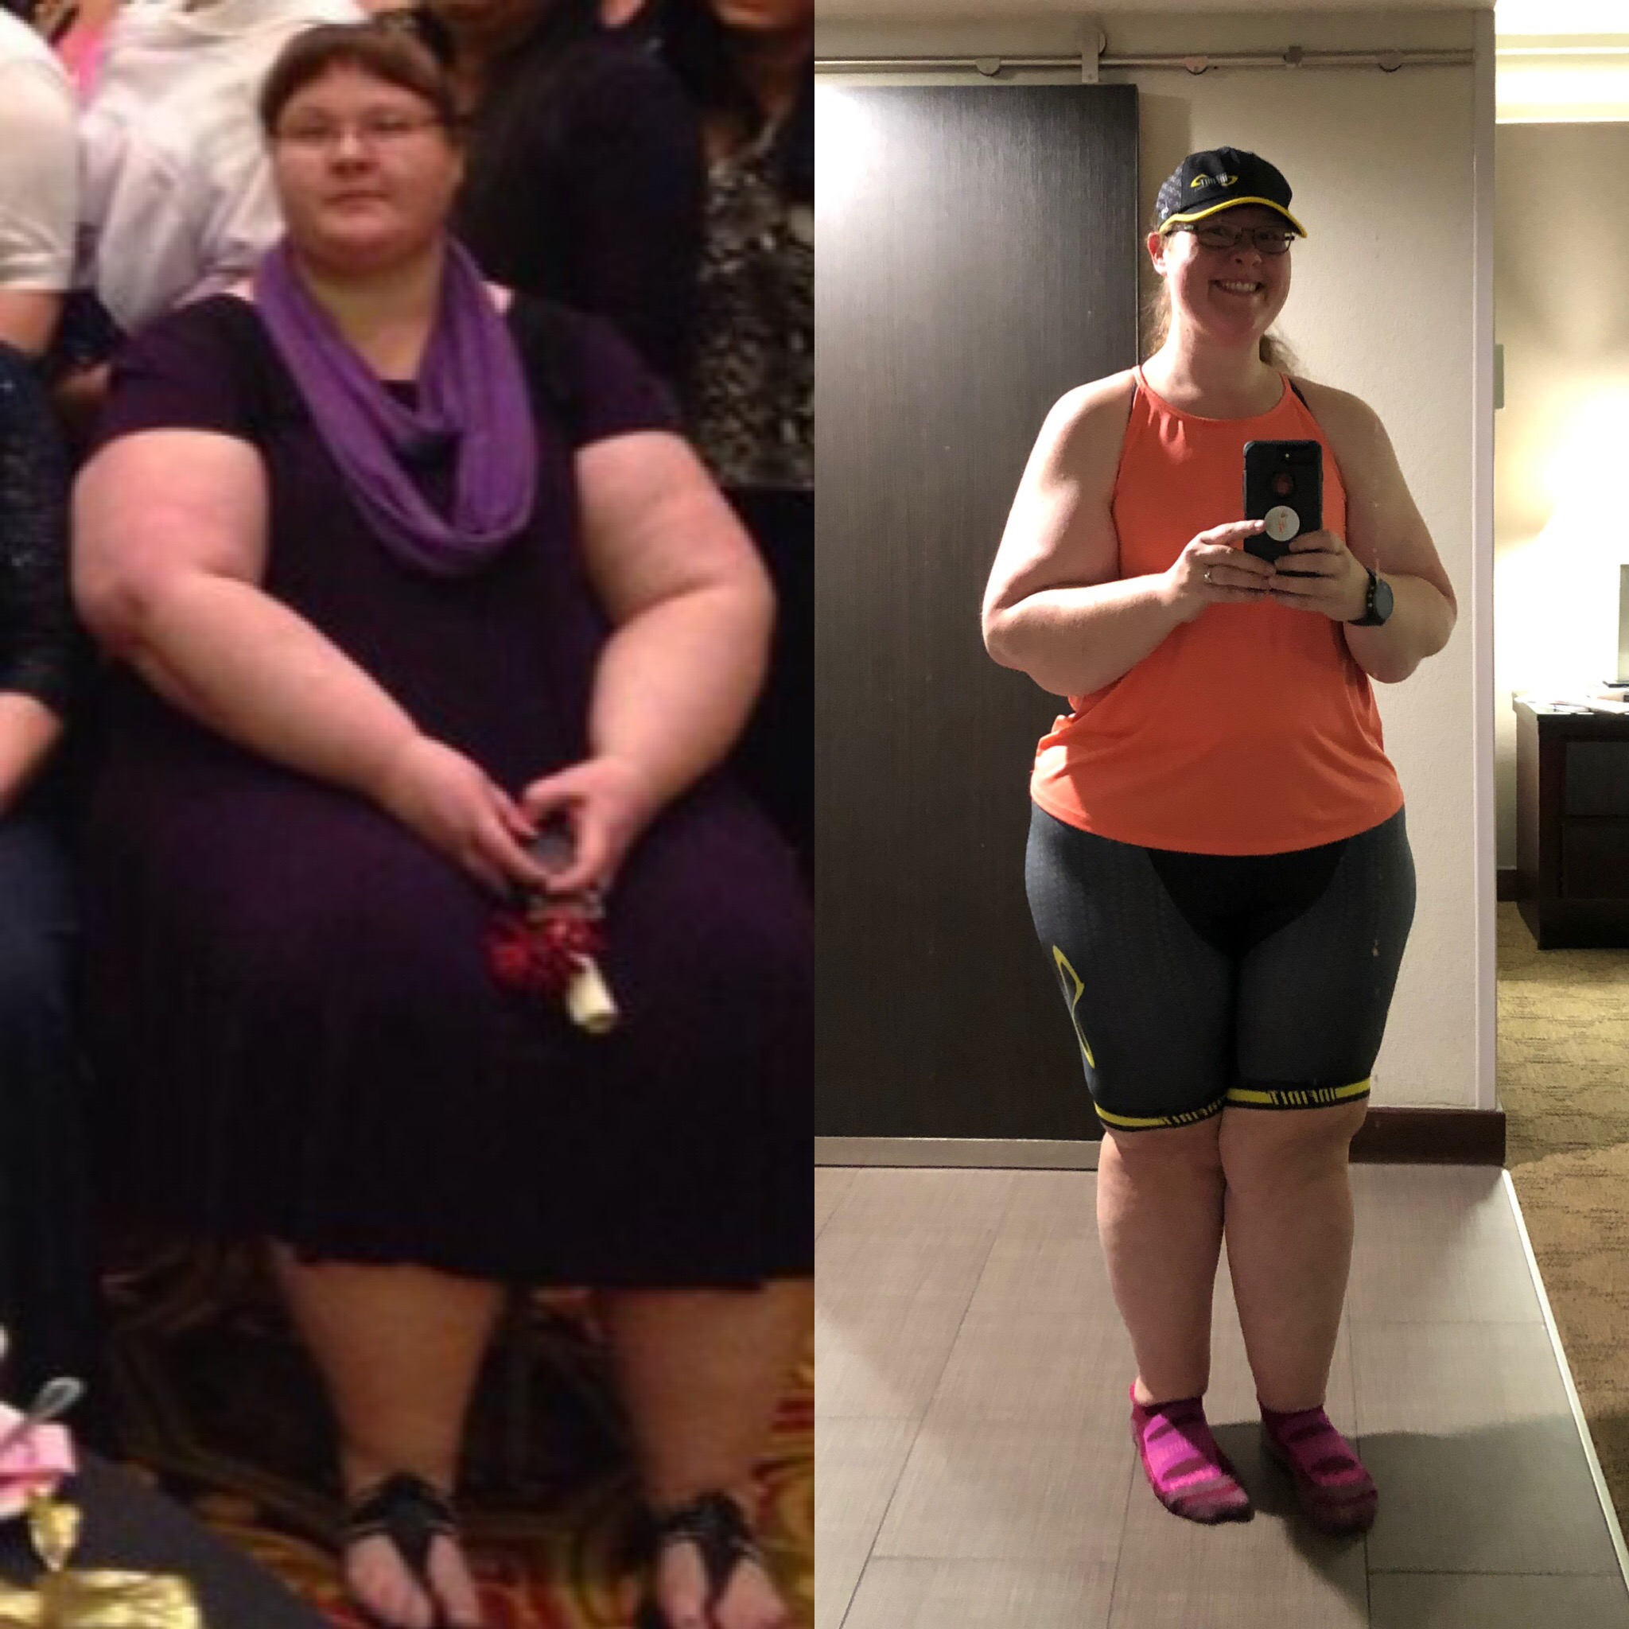
Imperfect
Hatred
Complacent
Purposeful
Inadequate
Joy-filled

Slide 4
Where did we go wrong?
³⁰ And you must love the Lord your God with all your heart, all your soul, all your mind, and all your strength.’ ³¹ The second is equally important: ‘Love your neighbor as yourself.’ No other commandment is greater than these.” (Mark 12:30-31)
Notes:
EQUALLY! That’s okay…let’s take a step back, how would we love others? What does that look like?

Slide 5
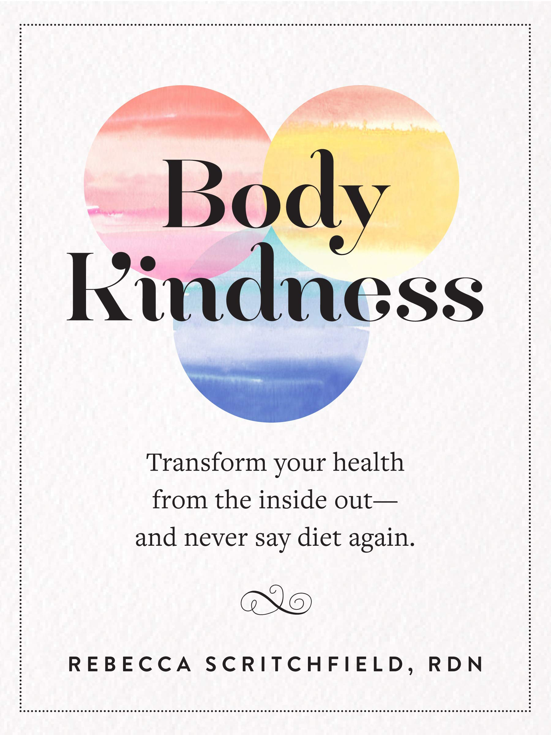
Part 1 of 3: Taking Care of Your Physical Self
Ditch the diets
Joyful Movement
Sleep

Slide 6

Part 2 of 3: Your Emotional Self/Your Mental Health
ALL FEELINGS MATTER
Make room for fun
Bounce back and GROW

Slide 7

Part 3 of 3: Who Are You? Your Faith.

Slide 8
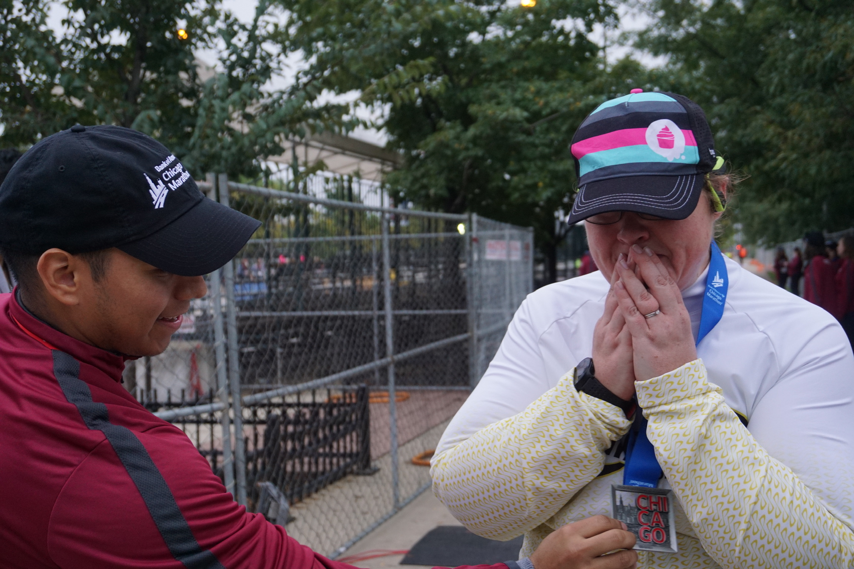
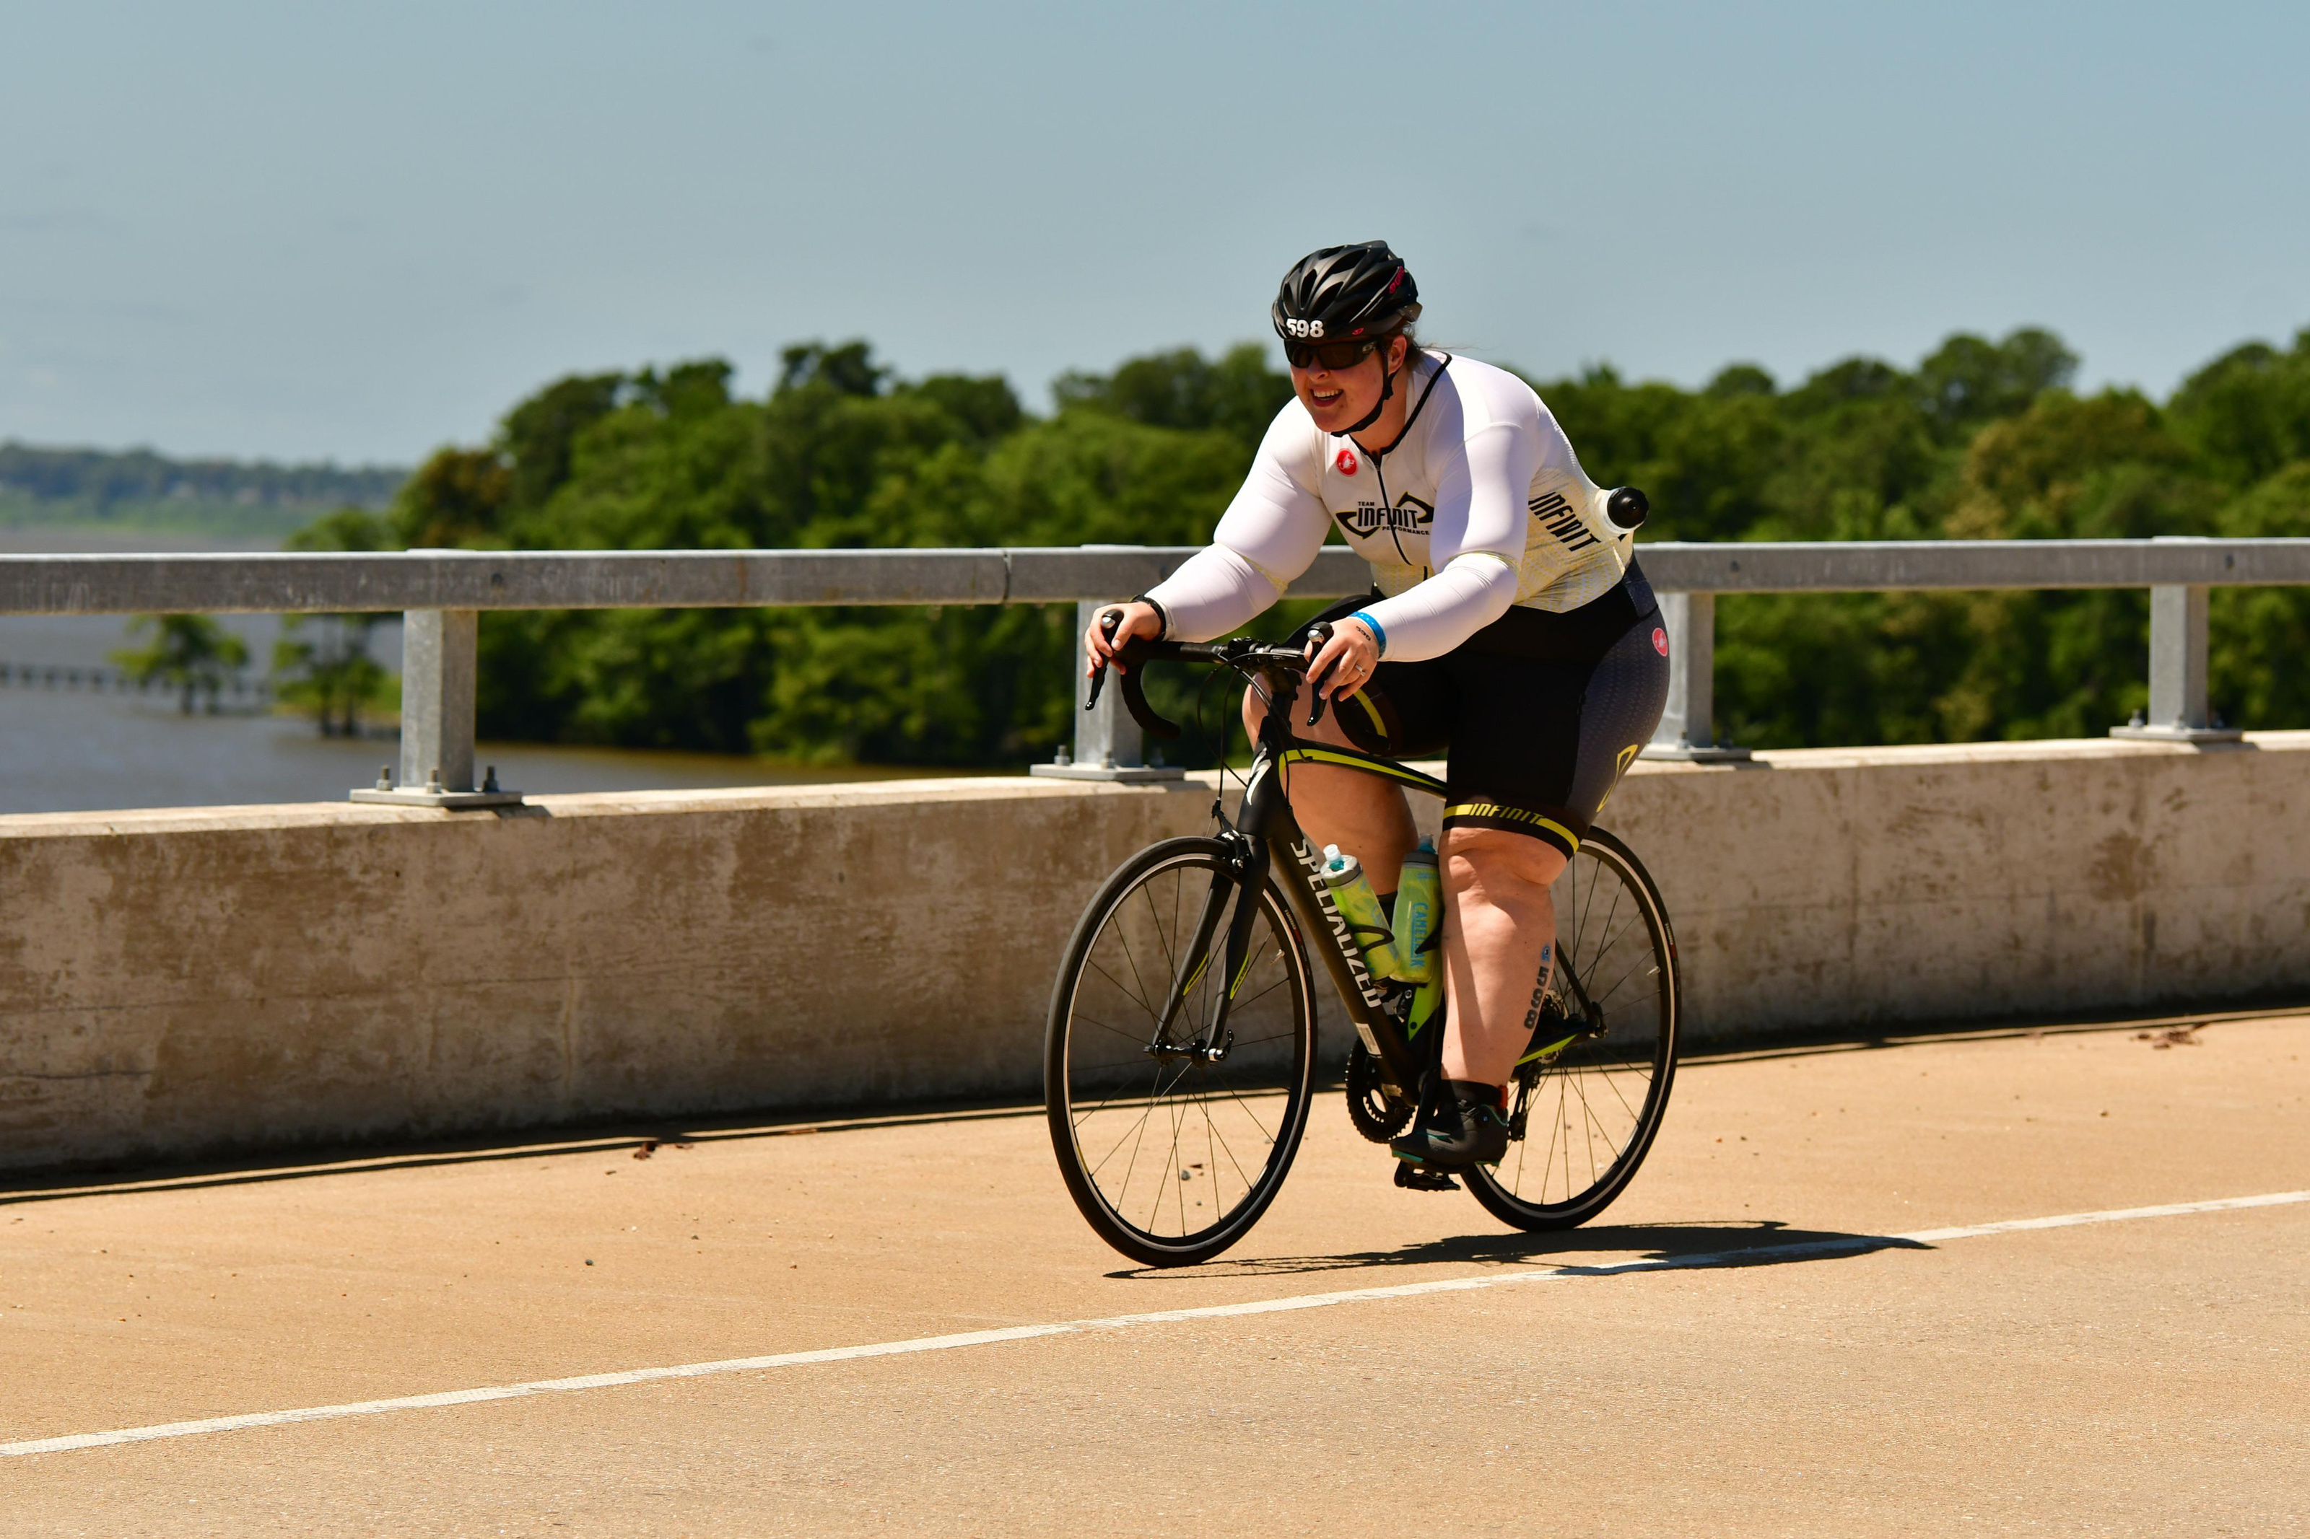
A few more tips
Accountability
Connections
Not everyday is going to be sunshine and roses
We are a constant work in progress
Feelings aren’t fact

Slide 9
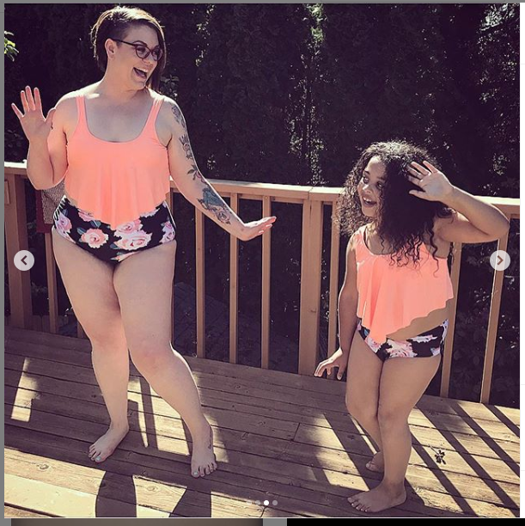
A few weeks ago I bought myself a two piece bathing suit and I took my 7 year old daughter to the pool. When I put on my new bathing suit (that I was crazy excited about), my daughter looked me over with eyes wide open. She was silent for a few seconds and then this was our conversation:
Leilah: “Uh.... I can see part of your belly.”
Me: “Yeah I know. That is on purpose.”
Leilah: “But your belly is kinda big and squishy... and it has scars on it.... Aren’t you embarrassed?”
Me: “I’m honest about my belly and the rest of my body. My body is strong and treats me well. I’m not sick, and I’m happy... My belly is kinda squishy and has scars on it because I had you and your brother, two of my favorite people in the world, living in it. Sometimes when women get to be mommies their bodies change, and being your mommy one of the best things in my whole life.
My body makes me happy. My kids make me happy. And this new bathing suit makes me happy”
Leilah: “...Wow. I like that....” A few seconds past and she says,
“Mommy.... can I have a bathing suit just like yours? I’d love to be twins.”
Me: “I’d love to be twins with you too”
Today her bathing suit came in the mail.

Slide 10
More Information
Body Kindness (Rebecca Scritchfield)
Intuitive Eating (Tribole & Resch)
Made to Crave, Your Best Yes (Lysa TerKeurst)
Let It Go, Keep It Shut (Karen Ehman)
The Renewing of the Mind Project (Barb Raveling)
Ask Questions! Stephanie.Lueras@usw.salvationarmy.org or @futureformerfatpastor on instagram

